Slide 1

Final Progress Report
DSCI '24 Cohort:
Cade Campise, Ethan Leamer, Stephen Lynch, Nick Mallow, Abigail Sandquist, Dr. Gerberry

Slide 2
Goal of Project

Slide 3
CMS Data + Census Data → Predict impact of BBB
Hosptial Service
Area Data
(Medicare discharges by zip code)
Census Data
(Demographic, Health Insurance)
HCRIS Data
(S-10, S-3, C-1)
Predicted Impact of the BBB

Slide 4
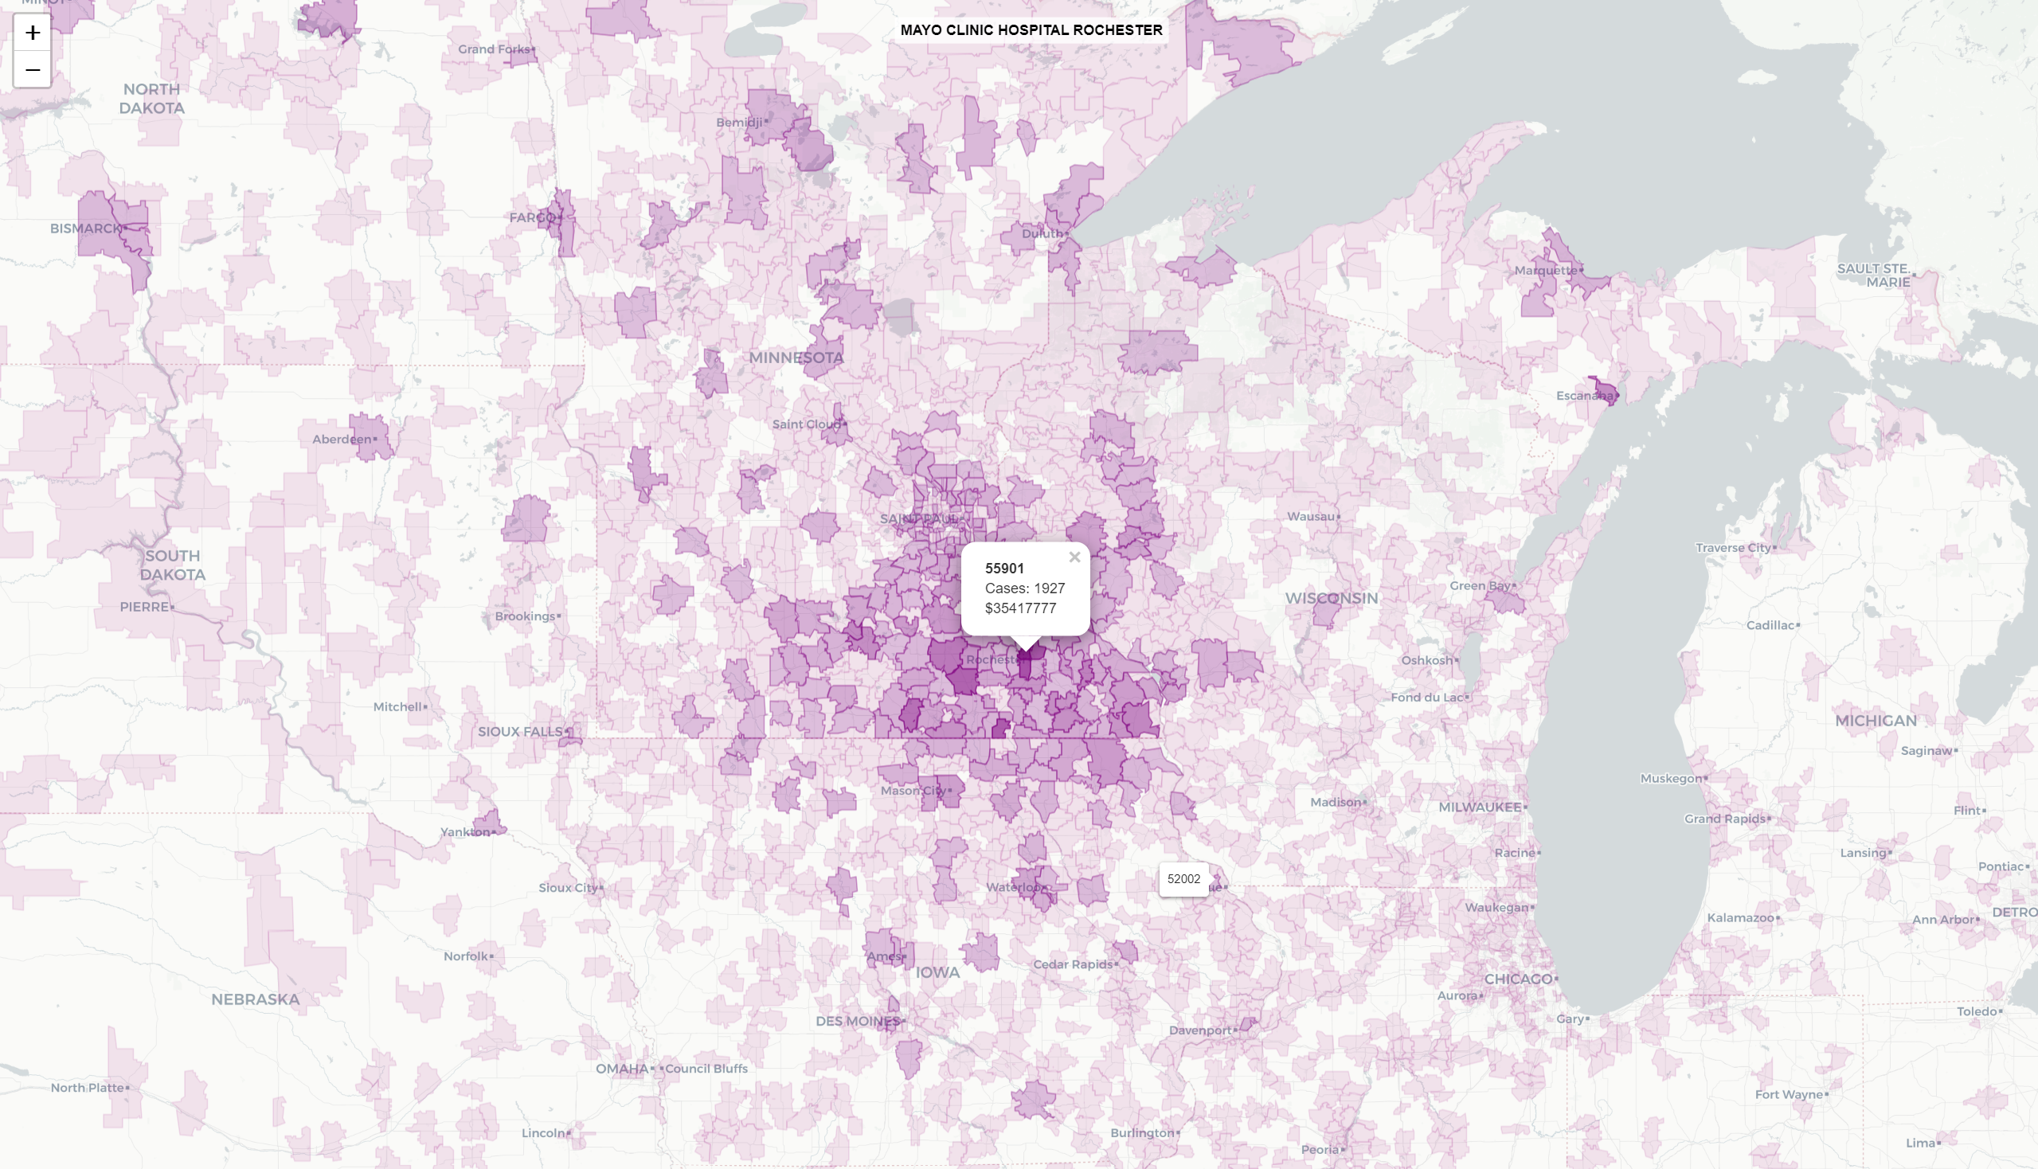
Hospital Service Areas
Zip codes are weighted by the number of cases
Darker the color the more cases came from that zip code

Slide 5
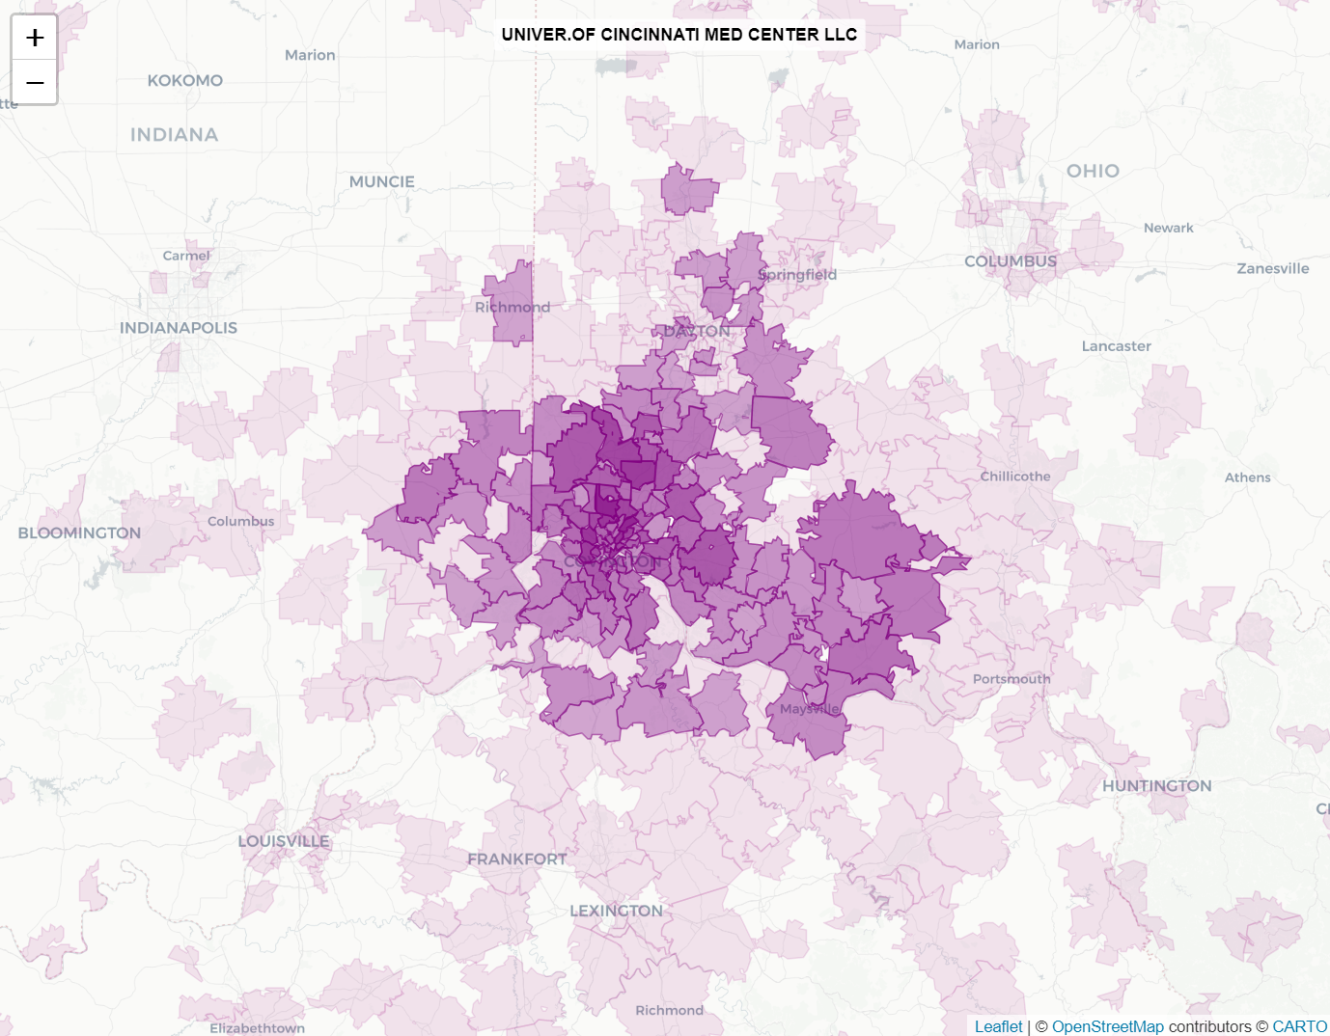
Hospital Service Area Visualizer
UC Medical Center as example

Slide 6
Findings

Slide 7
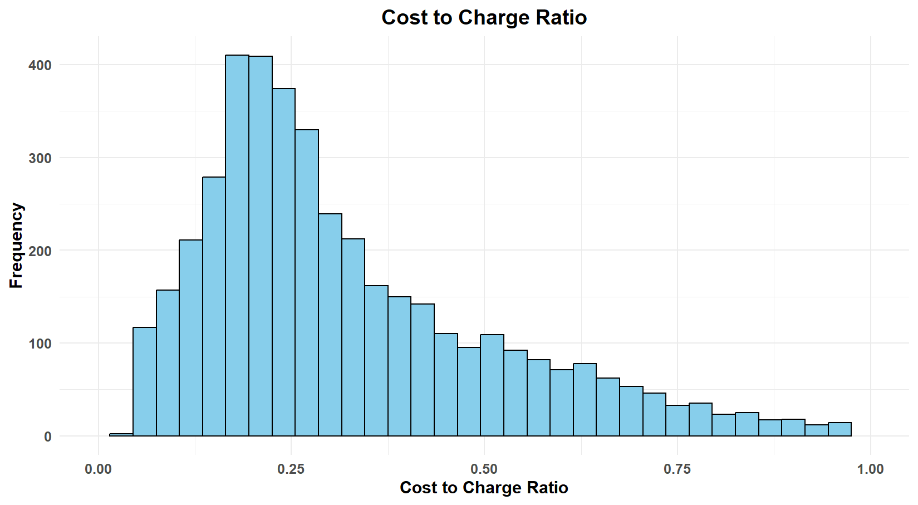
Cost-to-charge varies widely

Slide 8
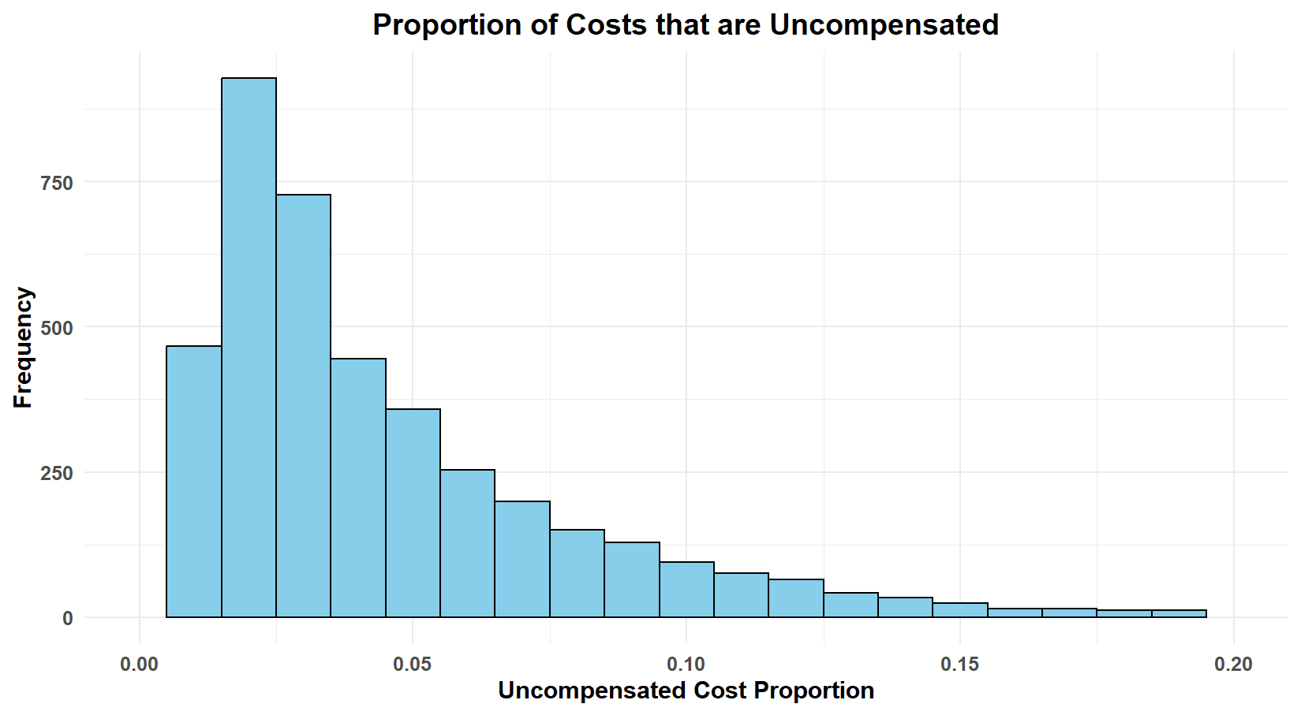
NOT including unreimbursed Medicaid (Line 30 / Line 202 from S-10 and C-1)
Notes:
Line 30: Cost of uncompensated care
Line 202: Total cost

Slide 9
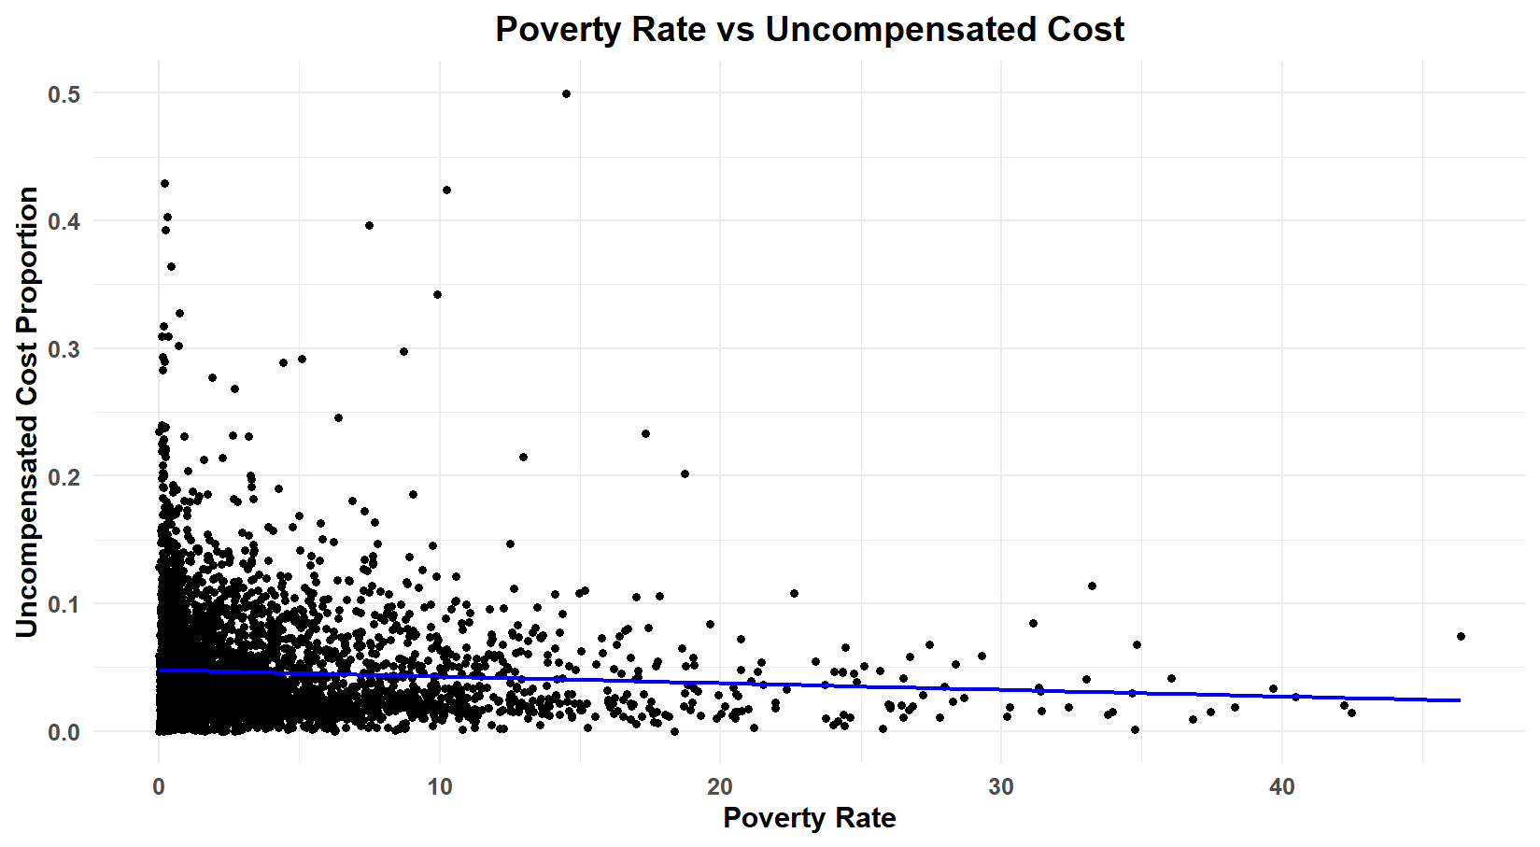
NOT including unreimbursed Medicaid (Line 30 / Line 202 from S-10 and C-1)

Slide 10
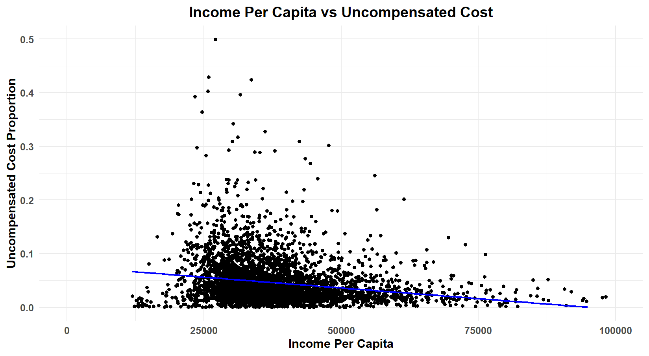
NOT including unreimbursed Medicaid (Line 30 / Line 202 from S-10 and C-1)

Slide 11
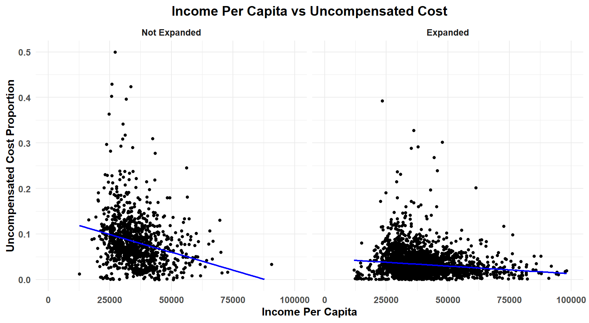
Stronger effect in states that did not expand Medicaid

Slide 12
Modeling Uncompensated Costs from Demographics

Slide 13
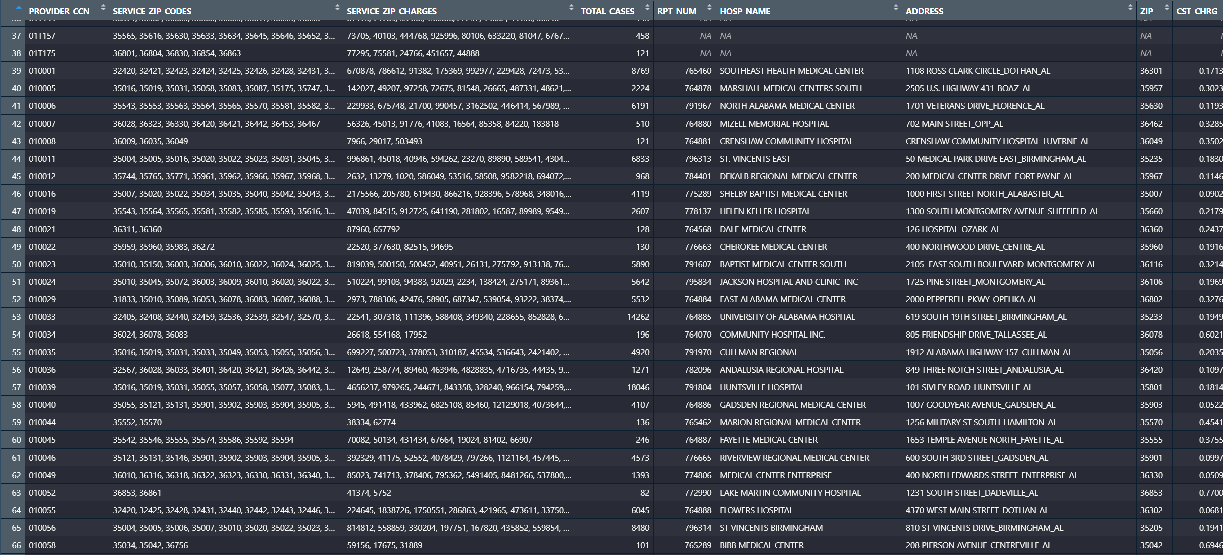
Combined data set (HCRIS + Service + Demographics)

Slide 14
In this data set
Hosptial Service
Area Data
(Medicare discharges by zip code)
HCRIS Data
(S-10, S-3, C-1)
Basic Demographics
(Age, Household Income)

Slide 15
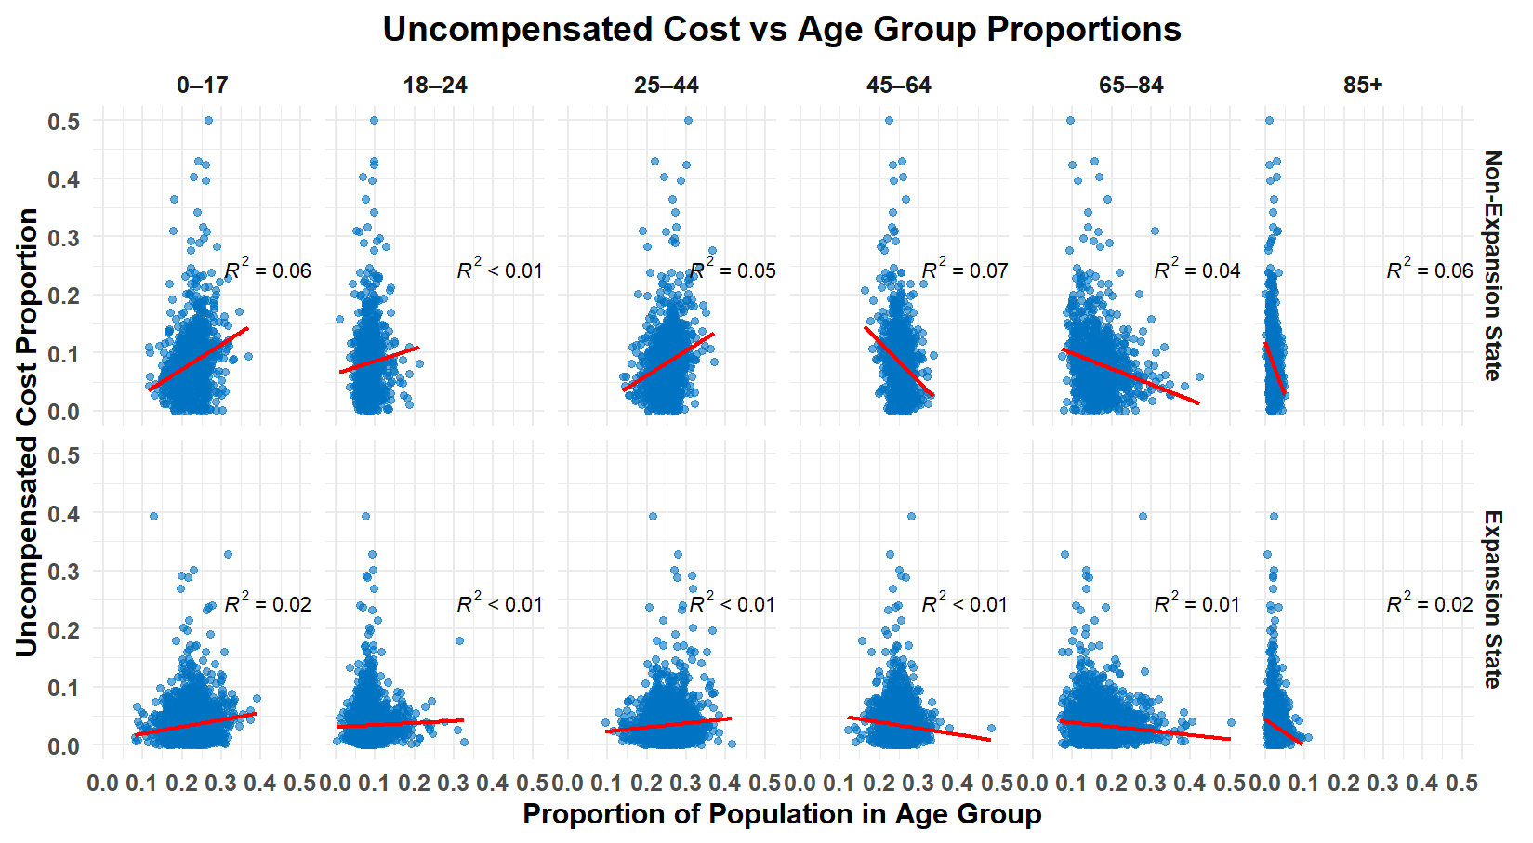

Slide 16
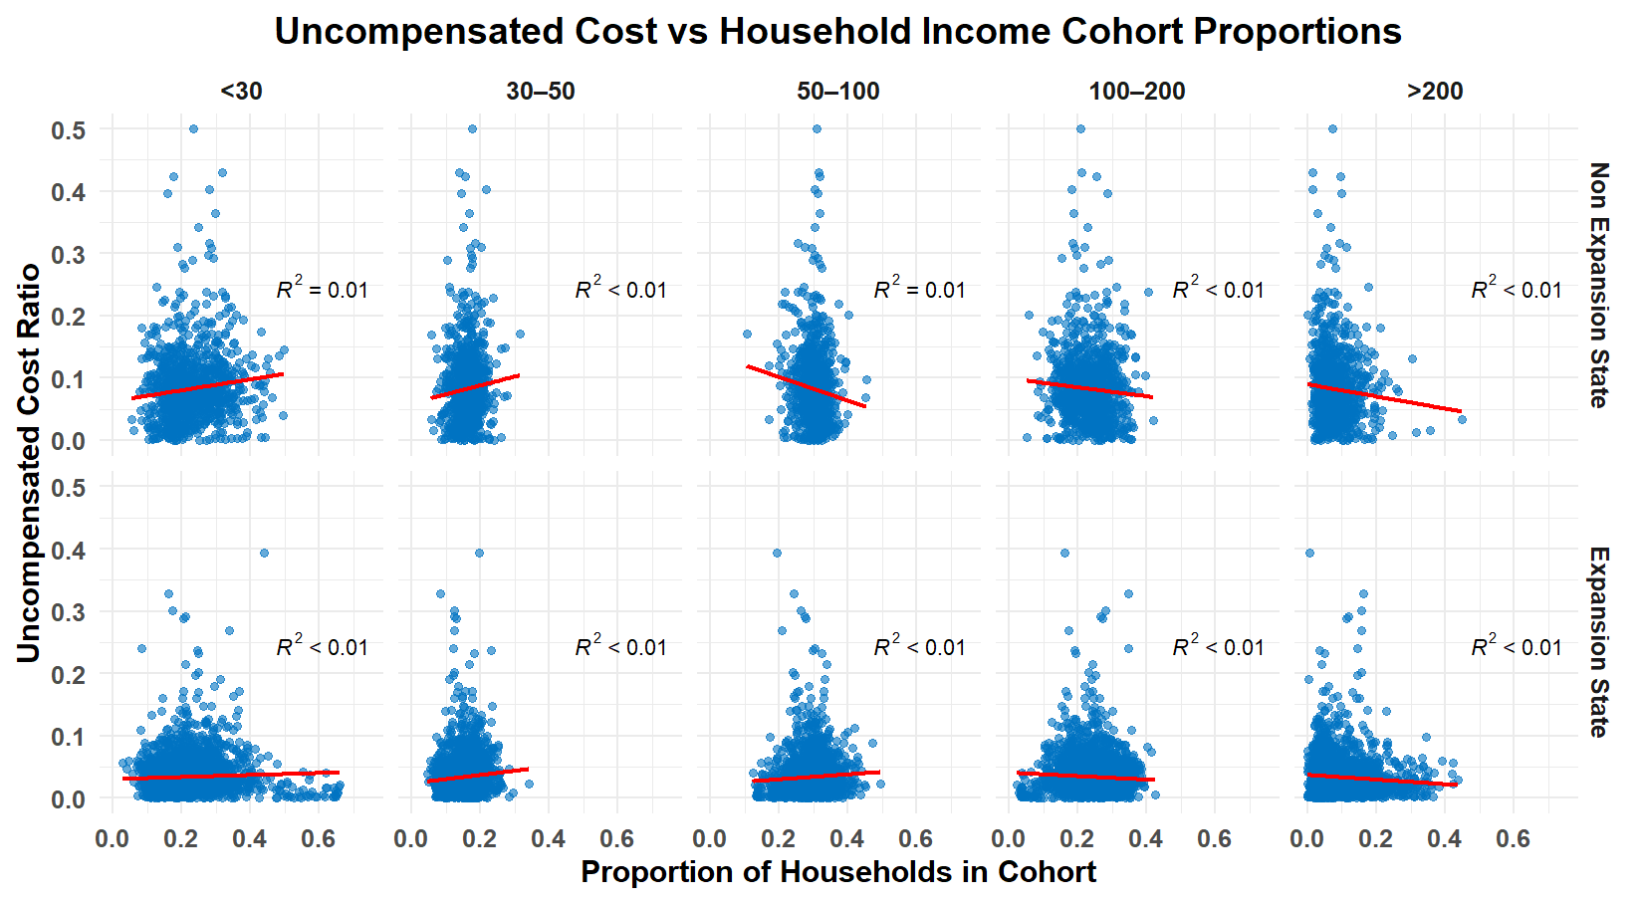

Slide 17
Modeling
Used Linear Regression, Regression Tree
R^2 ~ 0.20 (model only explained 20% of variance in outcome)
Challenges with using age and income Census data:
Uncompensated cost rates are noisy
Lacking clarity in evaluating effects of the BBB

Slide 18
Modeling Uncompensated Costs from Census Data on Health Insurance

Slide 19
New Additions to the Data Set
Types of Health Insurance Coverage by Age:
- Amount of people that have each type of coverage in each age cohort. (<19,19-34,35-64,>65)
One Type -
Employer Based
Direct Purchase
Medicaid
Medicare
Military Care (TRICARE & VA)
Two Type -
Employer Based and Direct Purchase
Employer Based and Medicare
Medicare and Medicaid
Other Private Only
Other Public Only
No Health Insurance Coverage

Slide 20
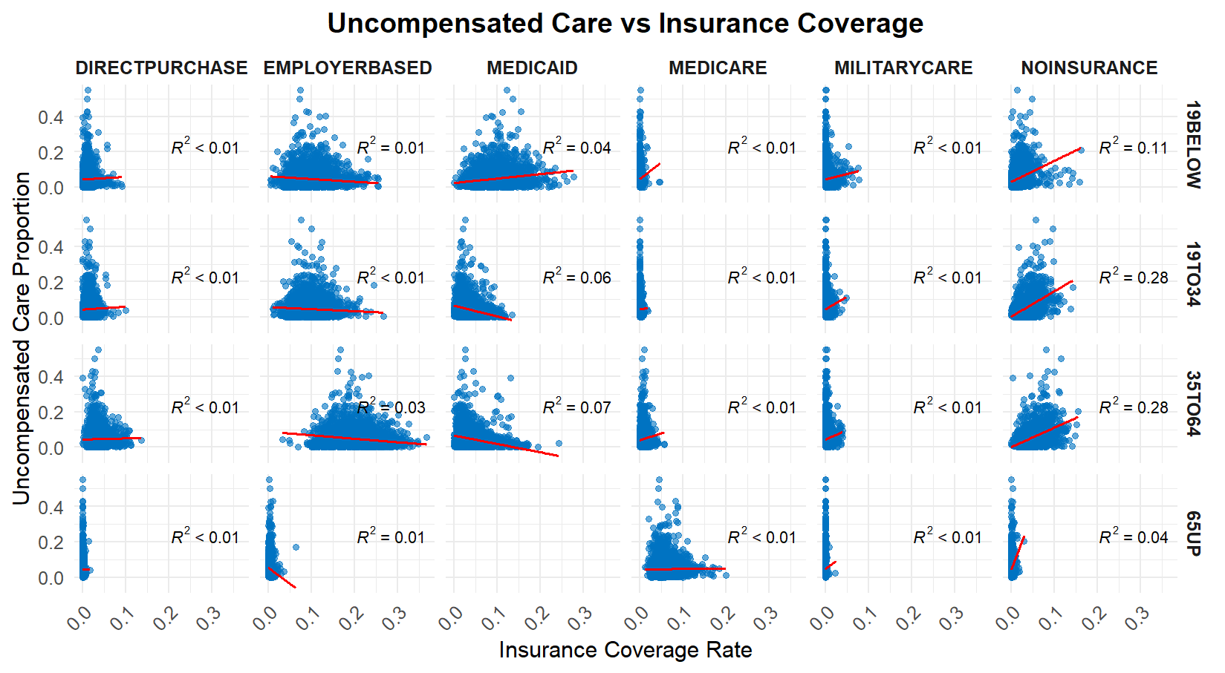

Slide 21
Modeling with new data
Simplicity vs. Complexity
Overfitting
Black Box models
Types of models used:
Linear
Beta
Random Forest

Slide 22
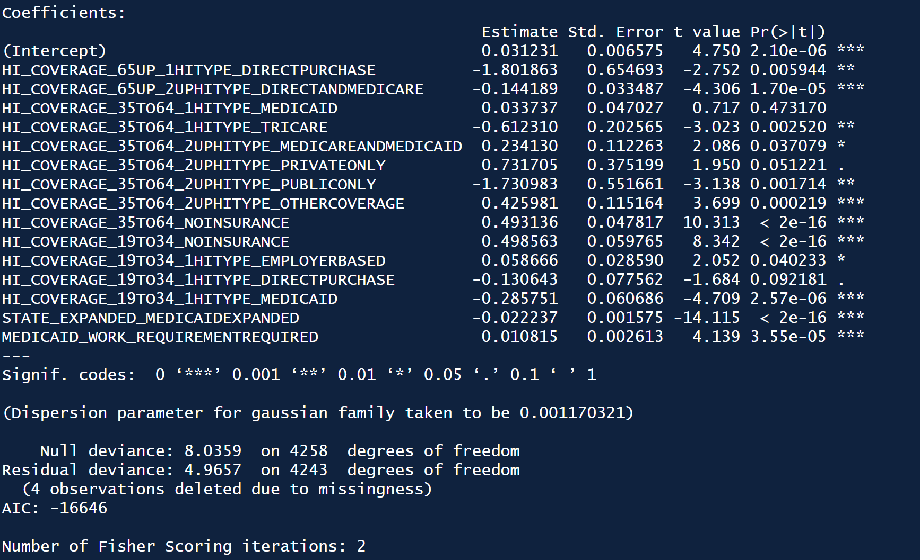
Linear Regression
R^2 = 0.38

Slide 23
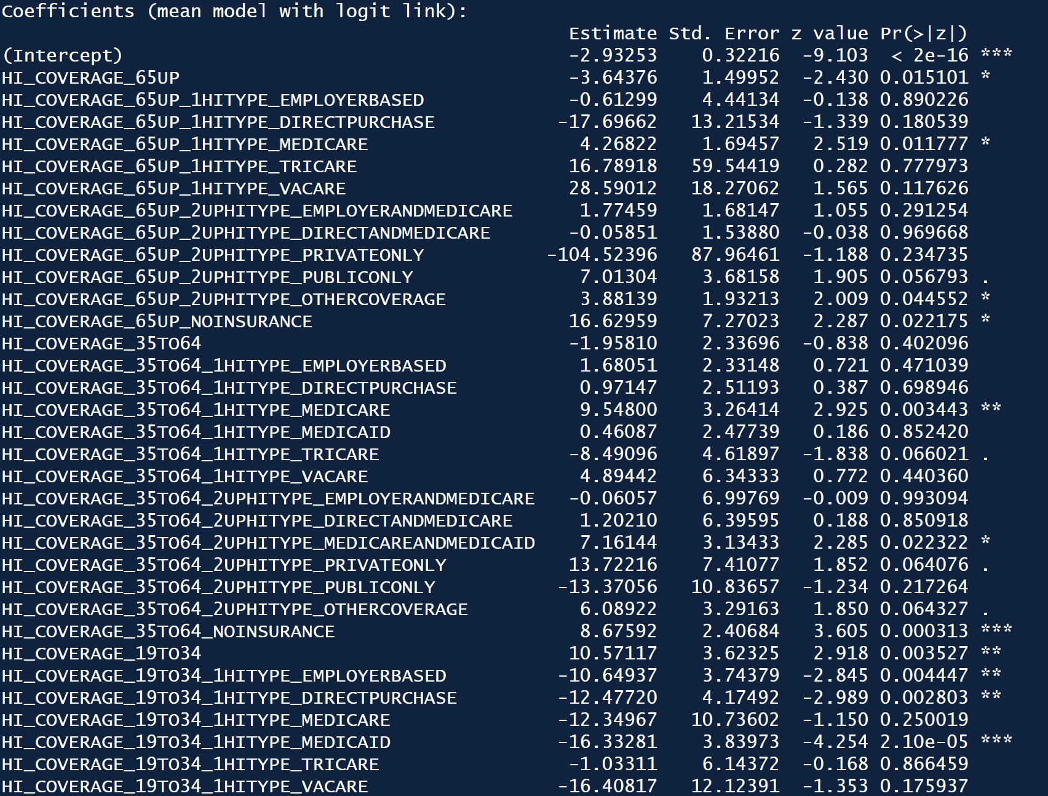
Beta Regression
R^2 = .30
Output always between 0-1

Slide 24
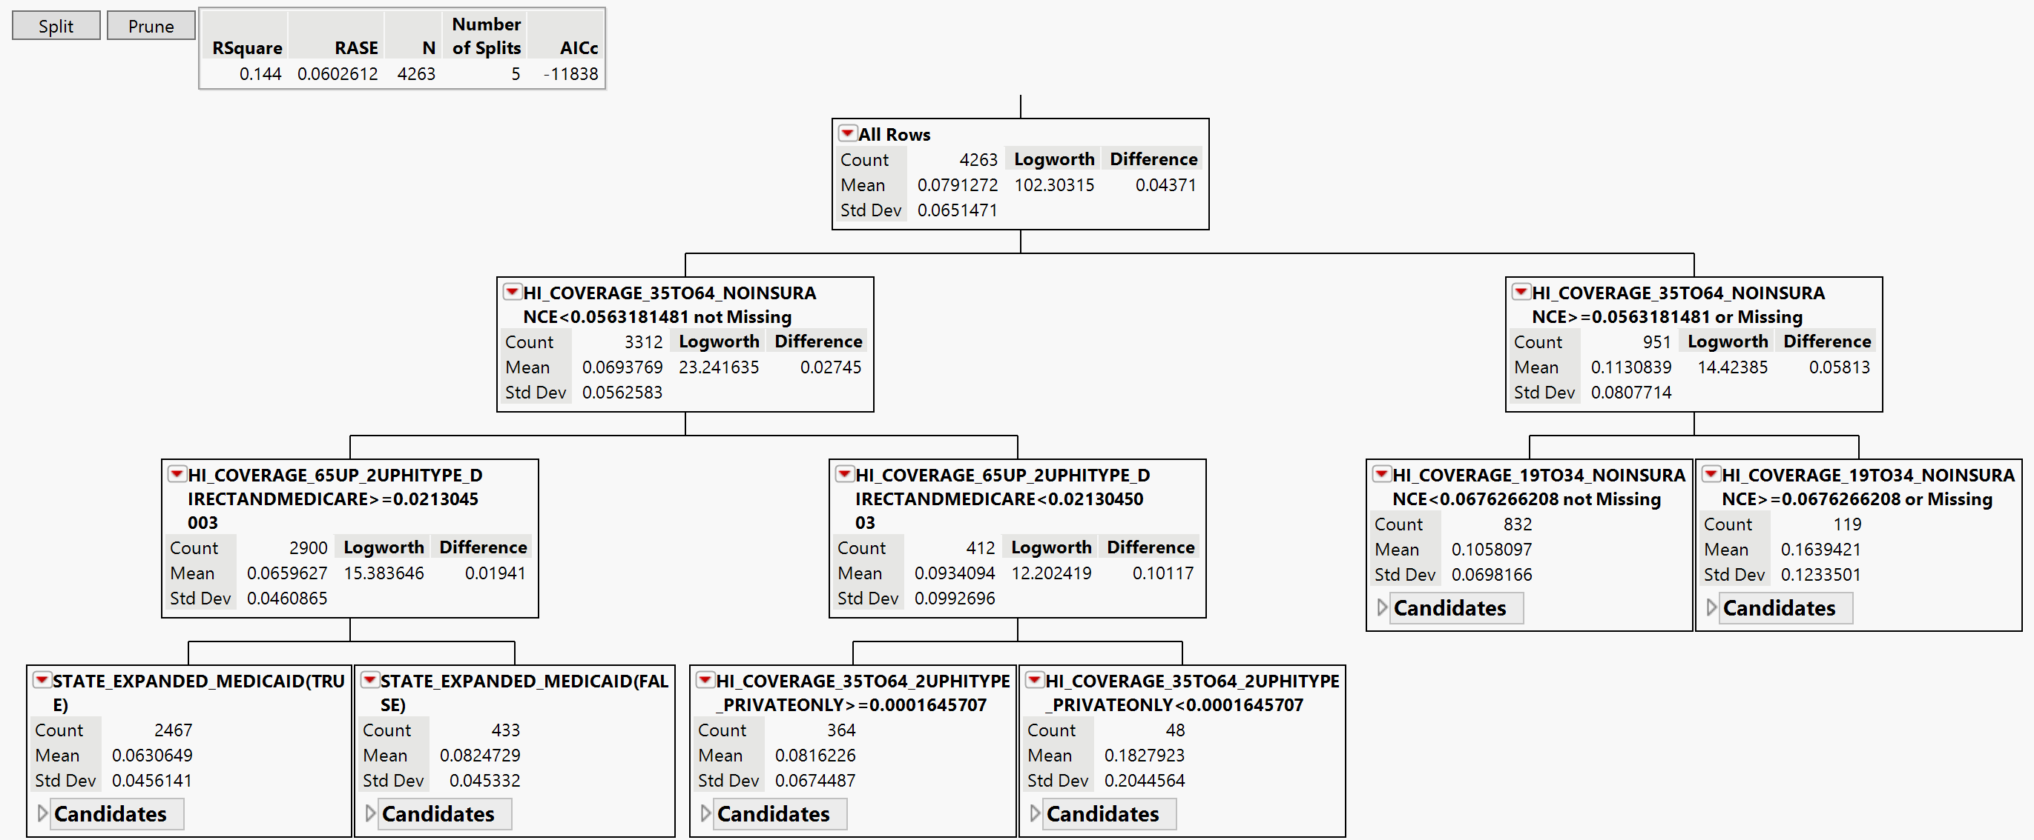
Regression Tree
Notes:
Usually used if linear relationship isn't strong The regression tree starts with the entire dataset at the root node.
At each node, it selects a feature and a threshold that best splits the data into two subsets, minimizing error.
Continues recursively, creating child nodes until a stopping condition is met, such as reaching a maximum depth or having too few samples to split further.
A higher logworth value indicates a more significant split, meaning that the input variable has a stronger association with the target variable.

Slide 25
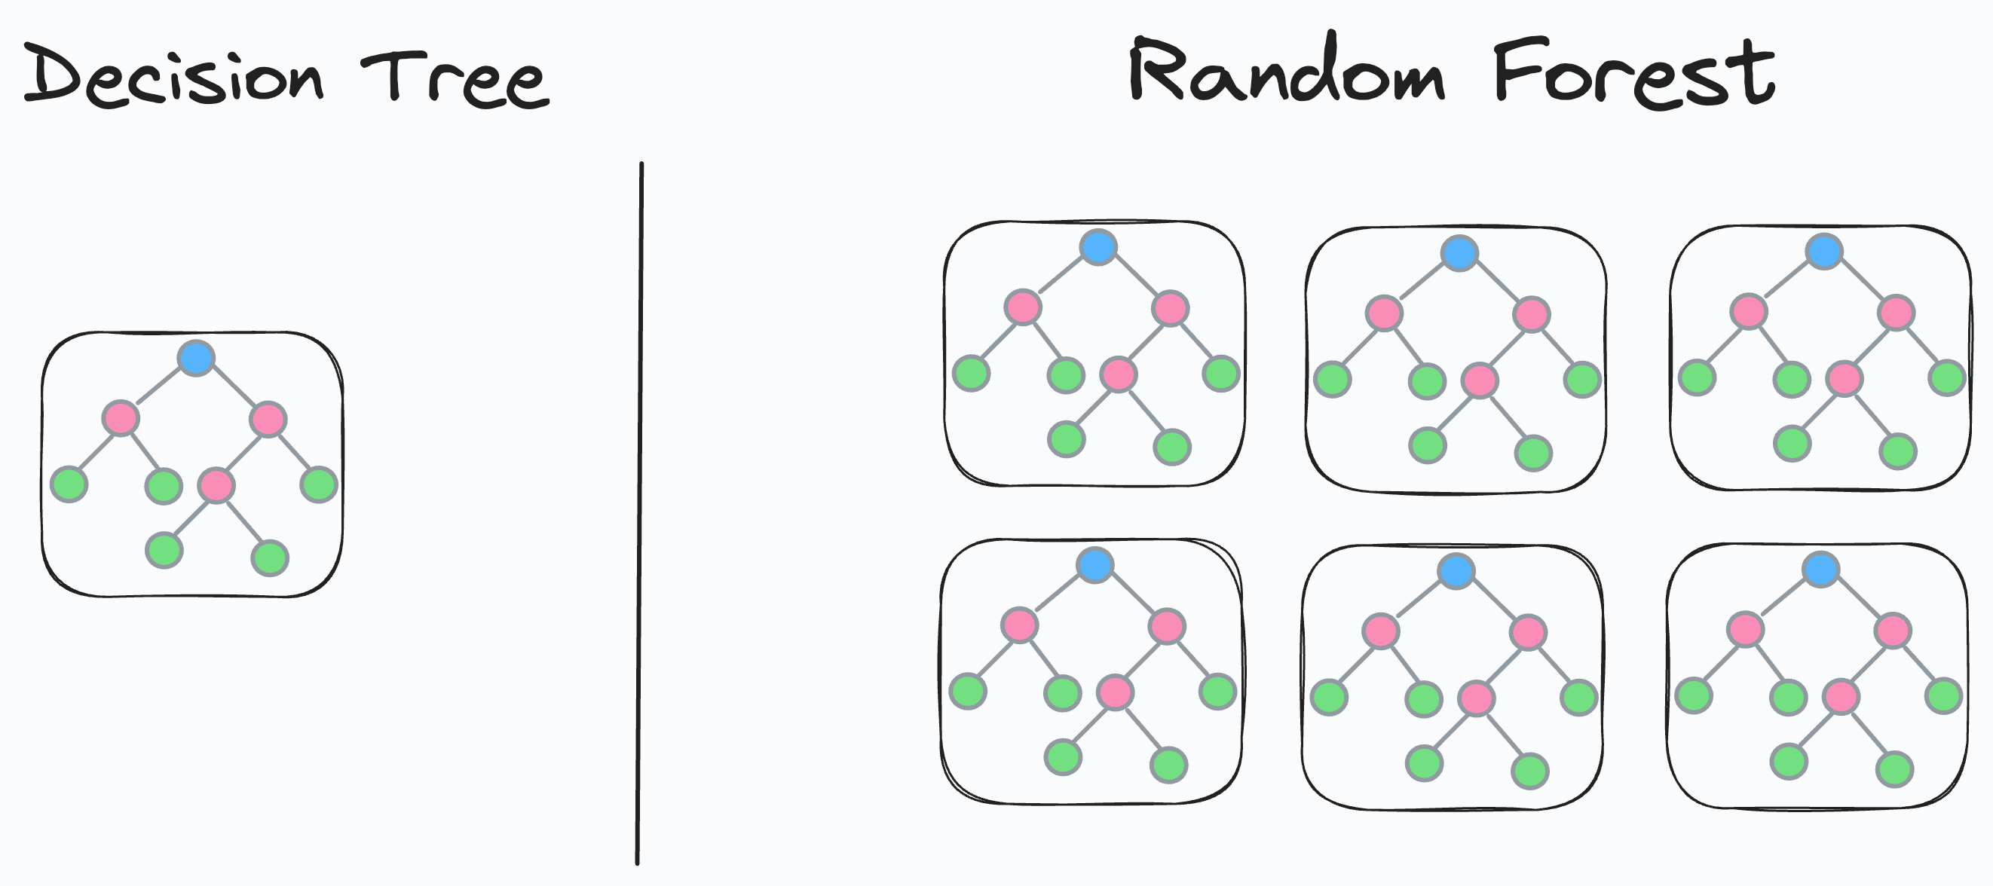
Random Forest
R^2 = .86
Makes 200 different trees with randomly sampled hospitals
"Black Box" - We are unable to tell what the model views as important
Notes:
Makes multiple regression trees and averages them
Usually used to help improve prediction accuracy and overfitting
Splitting Into training and validation data – shows there is most-likely overfitting

Slide 26
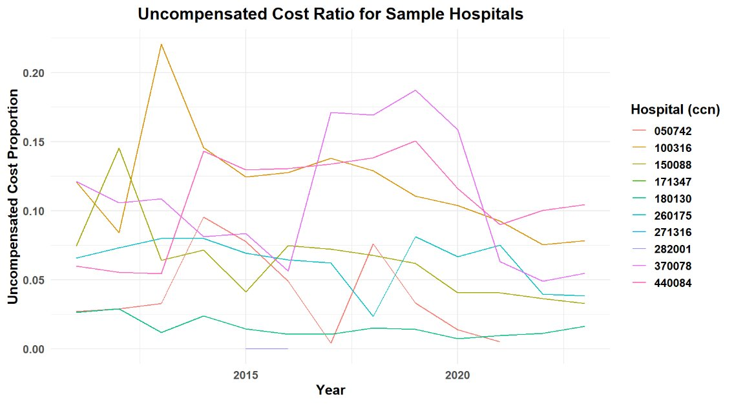
Uncompensated Costs are NOISY!

Slide 27
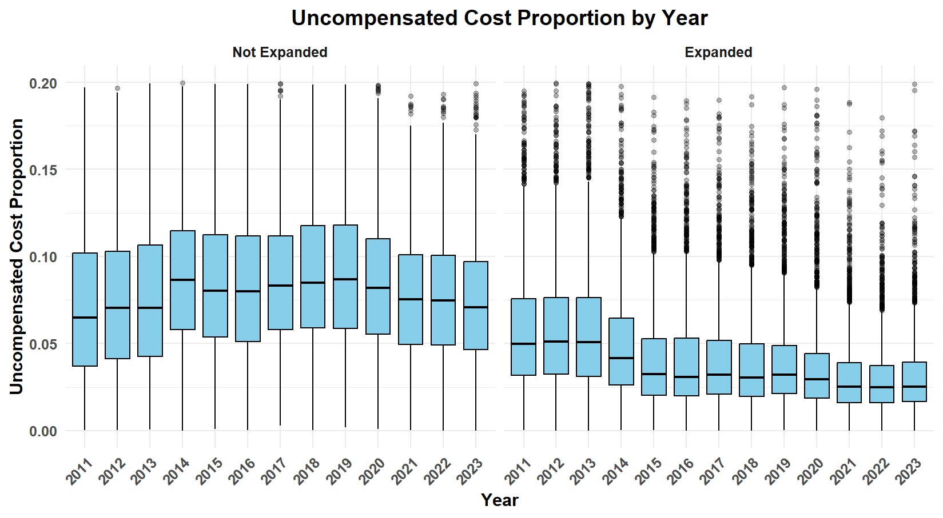

Slide 28
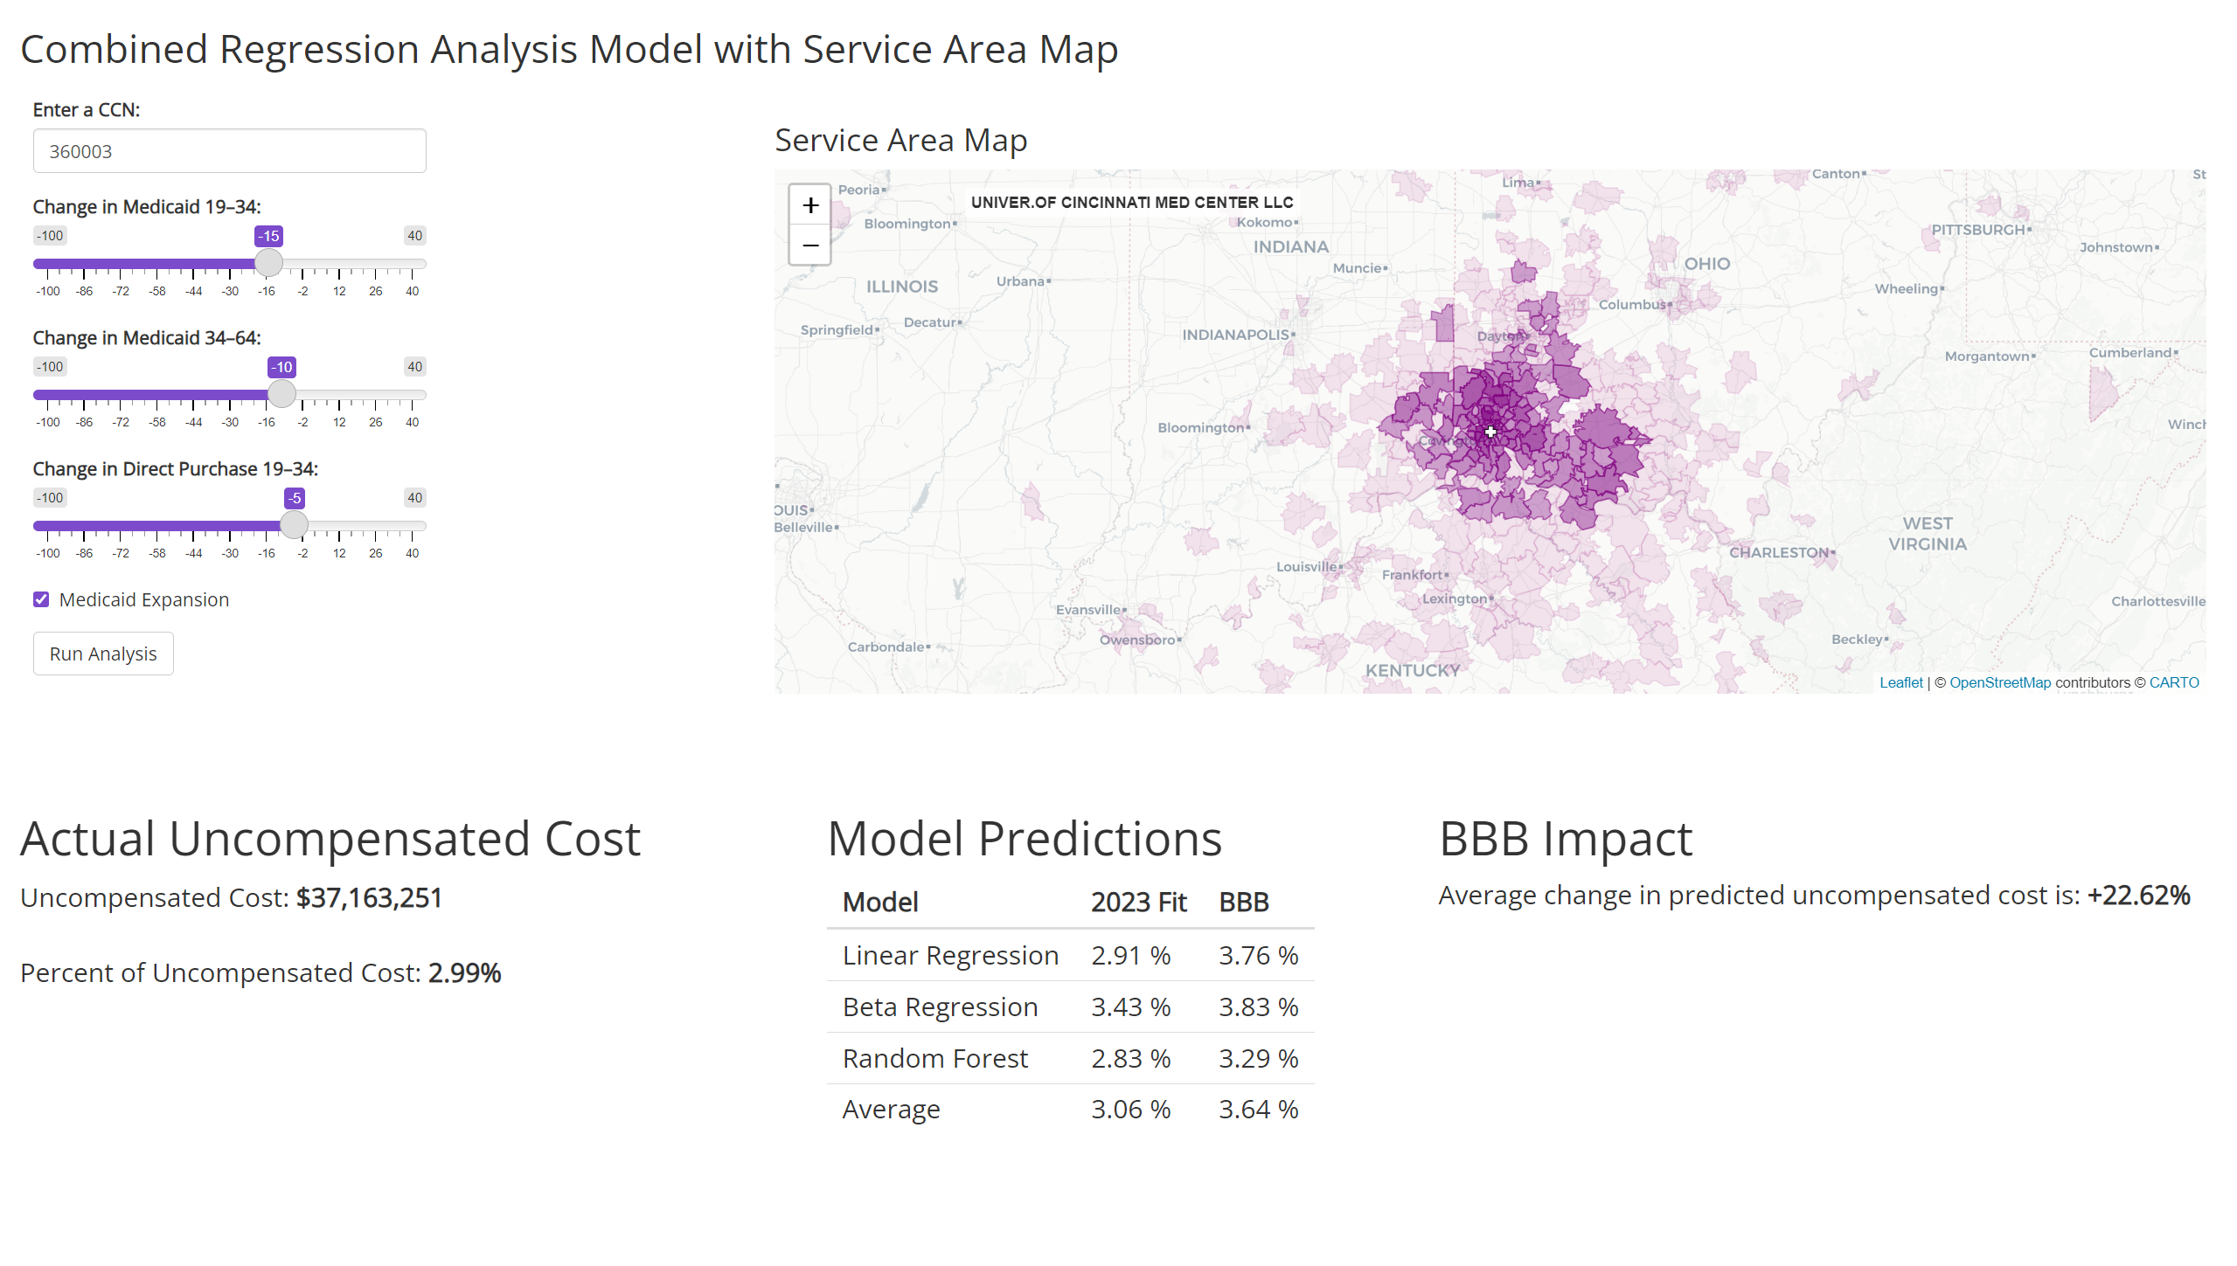
Final Product
Notes:
360003 UC
Huntion hosp 050438
Mayo Clinic 240001
Anderson 360001
Mclearn flint 230141
450235 small tx one

Slide 29
Conclusions
Limitations
Hospital Service Area: created from Medicare-only discharges
Noisy data
Ideas for future:
Train models on multi-year data (reduce noise)
Outliers = "BUSINESS OPPORTUNITY"
"Peer hospitals have much lower uncompensated costs... Forvis Mazars can help!!"

Slide 31
